Slide 1
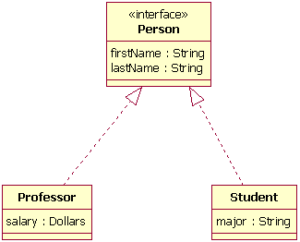
Interfaces
Interfaces are contracts that defines how the software will interact with outside world.
Using an interface we define what a class must do, not how it does this.
reference type, similar to a class, that can contain only constants, method signatures, default methods, static methods, and nested types.
Method bodies exist only for default methods and static methods.
Interfaces cannot be instantiated.
Variables should be public, static and final.
We can have Interfaces with no constants and method defiled i.e empty interfaces like java.lang.Serializable. These are called marker interfaces.
Ex:
Automobile manufacturers write software (Java, of course) that operates the automobile—stop, start, accelerate, turn left, and so forth.
Electronic guidance instrument manufacturers, make computer systems that receive GPS (Global Positioning System) position data and wireless transmission of traffic conditions and use that information to drive the car

Slide 2
Interfaces and inheritance
Defining Interface:
public interface OperateCar {
// constant declarations, if any
// method signatures
// An enum with values RIGHT, LEFT
int turn(Direction direction, double radius, double startSpeed, double endSpeed);
}
Interface extending multiple interfaces.
public interface GroupedInterface extends Interface1, Interface2, Interface3 {
// constant declarations
// base of natural logarithms
double E = 2.718282;
// method signatures
void doSomething (int i, double x);
int doSomethingElse(String s);
}
Lab12.1: Demonstration of using Interfaces

Slide 3
Interfaces
Using Interface as a type
public Object findLargest(Object object1, Object object2) {
Relatable obj1 = (Relatable)object1;
Relatable obj2 = (Relatable)object2;
if ((obj1).isLargerThan(obj2) > 0)
return object1;
else
return object2;
}
public class MyClass implements InterfaceA {
/**
* @param args the command line arguments
*/
public static void main(String[] args) {
// TODO code application logic here
}
public void saySomething() {
System.out.println("Hello World");
}
public void sayHi() {
System.out.println("implemetation of sayHi() in MyClass");
}
}
Lab12.2: Demonstration of interface using the example of Relatable

Slide 4
Interfaces
public interface DoIt {
void doSomething(int i, double x);
int doSomethingElse(String s);
}
public interface DoIt {
void doSomething(int i, double x);
int doSomethingElse(String s);
boolean didItWork(int i, double x, String s);
}
public interface DoItPlus extends DoIt {
boolean didItWork(int i, double x, String s);
}
Evolving Interfaces :Interfaces can have “default” methods since Java 8.
interface InterfaceA {
public void saySomething();
default public void sayHi() {
System.out.println("Hi from InterfaceA");
}
}
public interface DoIt {
void doSomething(int i, double x);
int doSomethingElse(String s);
default boolean didItWork(int i, double x, String s) {
// Method body
}
}

Slide 5
Interfaces
Extending interfaces that have default method:
Not mention the default method at all, which lets your extended interface inherit the default method.
Re-declare the default method, which makes it abstract.
Redefine the default method, which overrides it.
Lab12.3: Demonstration of interface using default method
Lab12.4: Demonstration of interface using enum constants using Card game

Slide 6
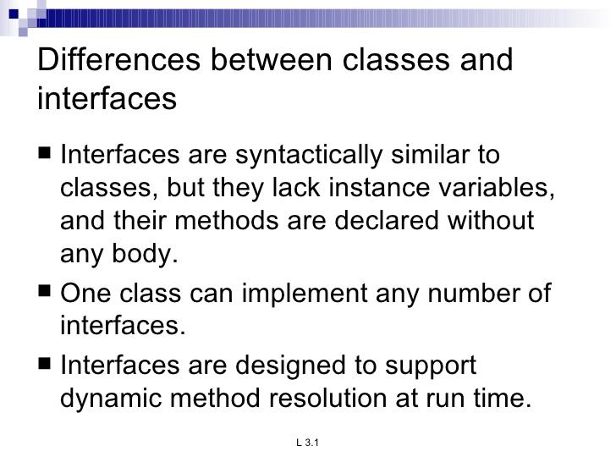
Interfaces

Slide 7
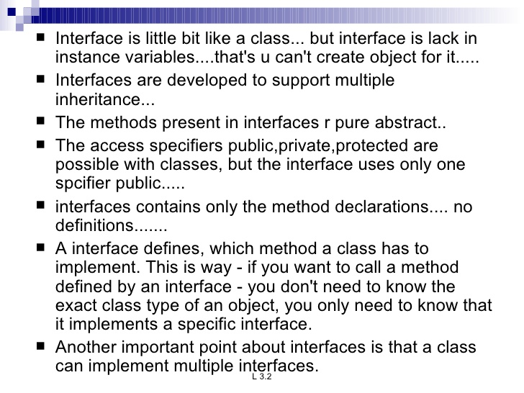
Interfaces

Slide 8
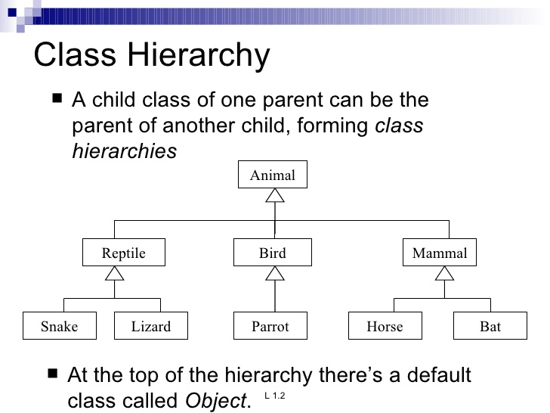
inheritance

Slide 9
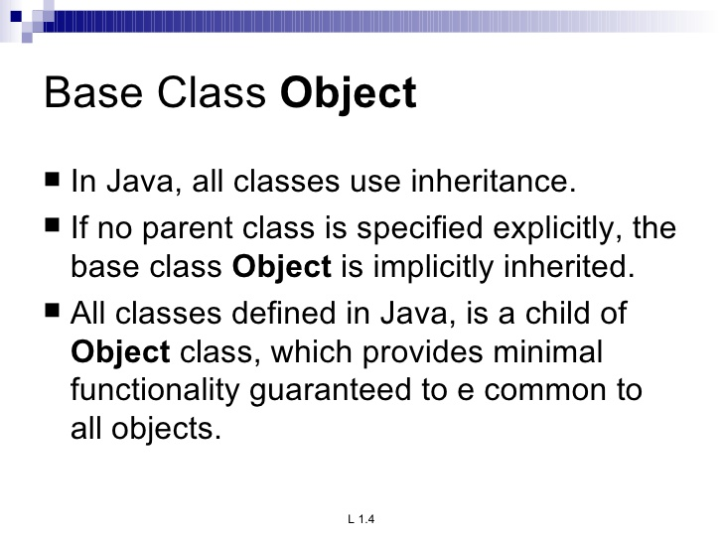
inheritance

Slide 10
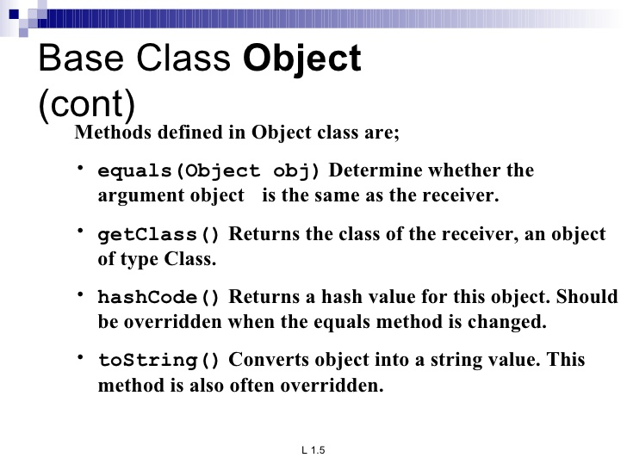
inheritance

Slide 11
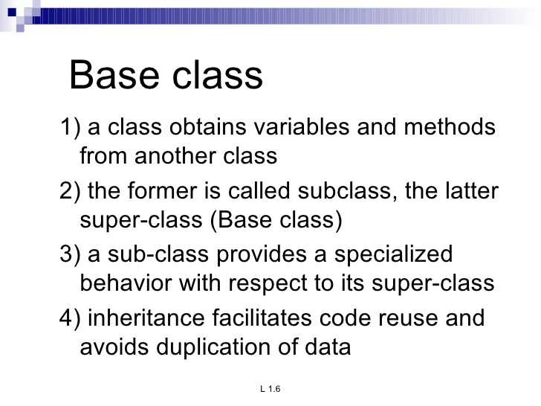
inheritance

Slide 12
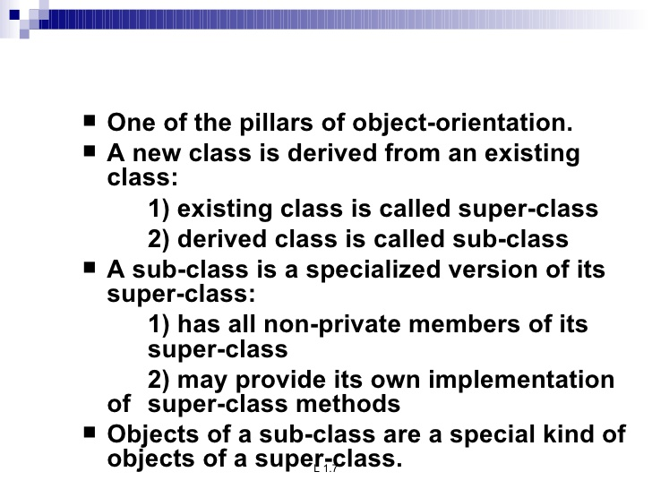
inheritance

Slide 13
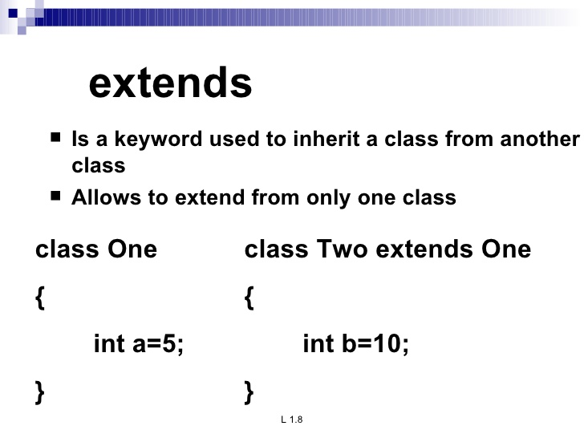
inheritance

Slide 14
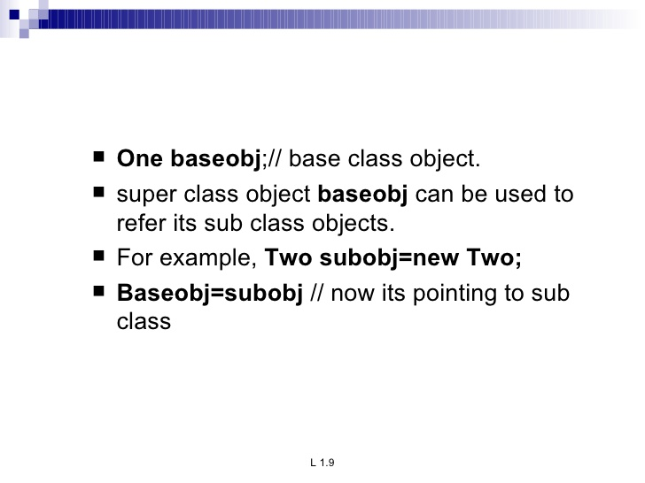
inheritance
Lab13.1: Demonstration of Inheritance using super class and sub-class:

Slide 15
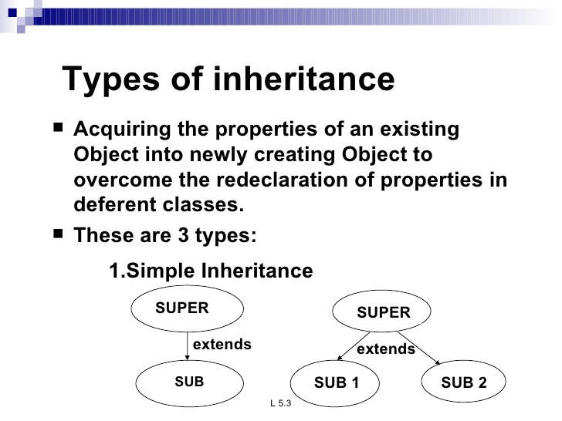
inheritance

Slide 16
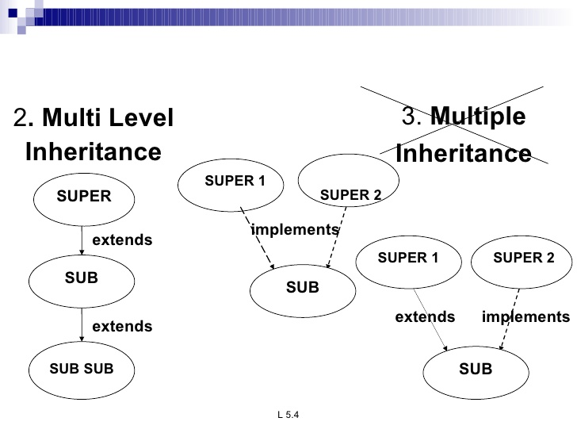
inheritance

Slide 17
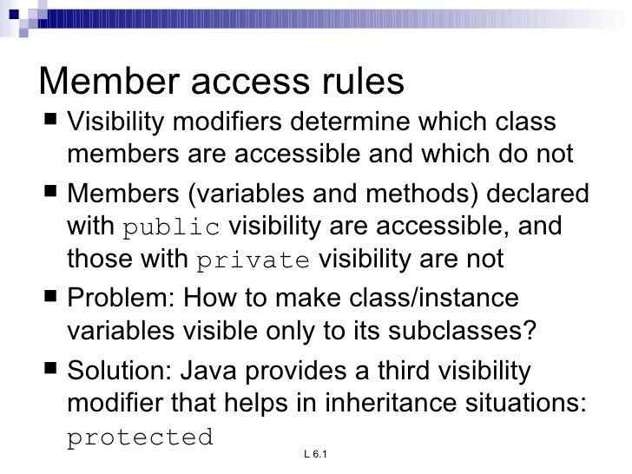
inheritance

Slide 18
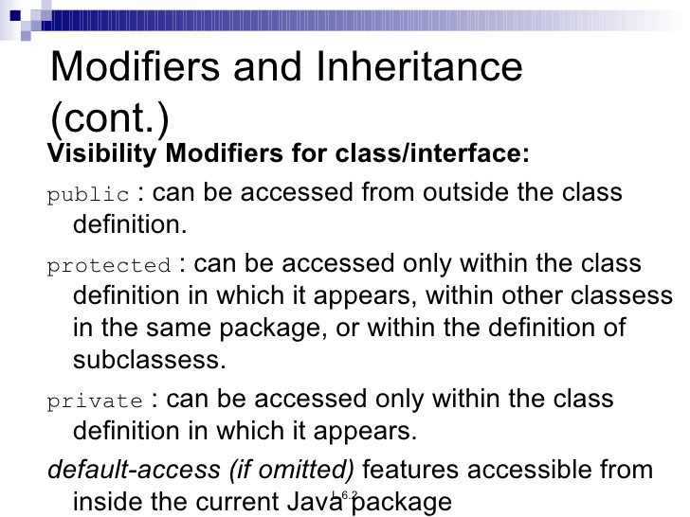
inheritance

Slide 19
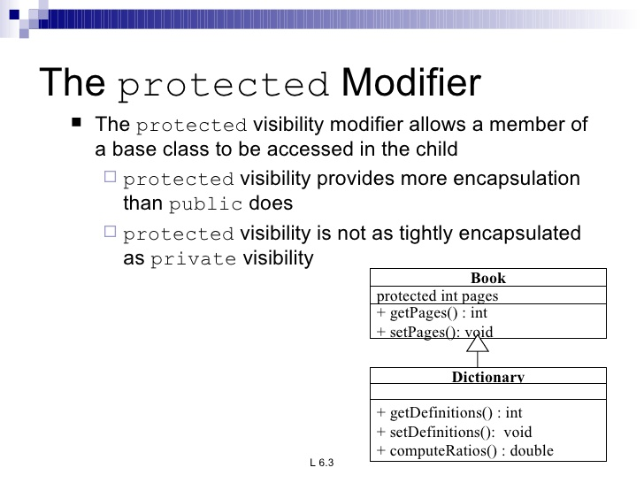
inheritance

Slide 20
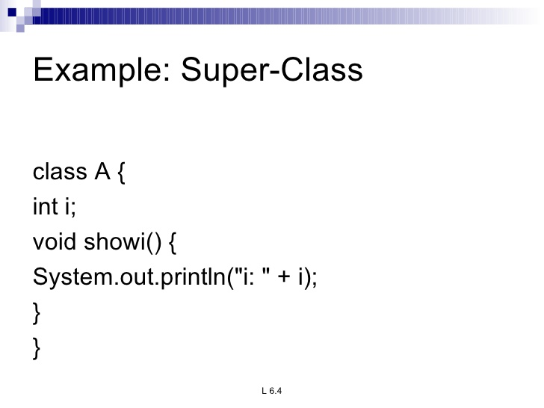
inheritance

Slide 21
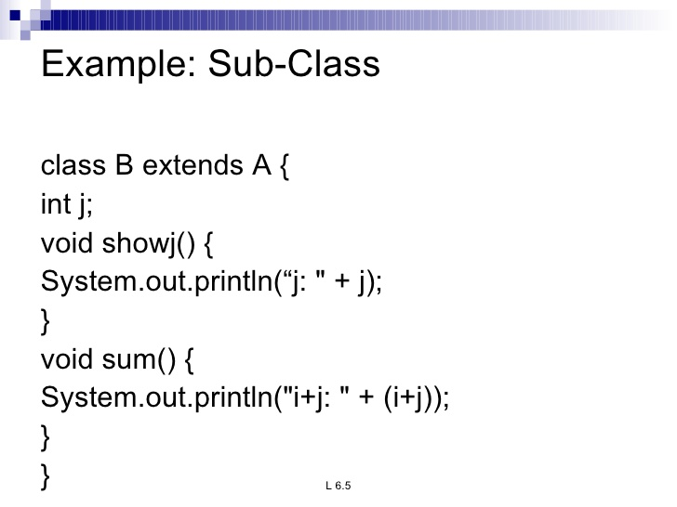
inheritance
Instanceof operator
Object obj = new MountainBike();
if (obj instanceof MountainBike) {
MountainBike myBike = (MountainBike)obj;
}

Slide 22
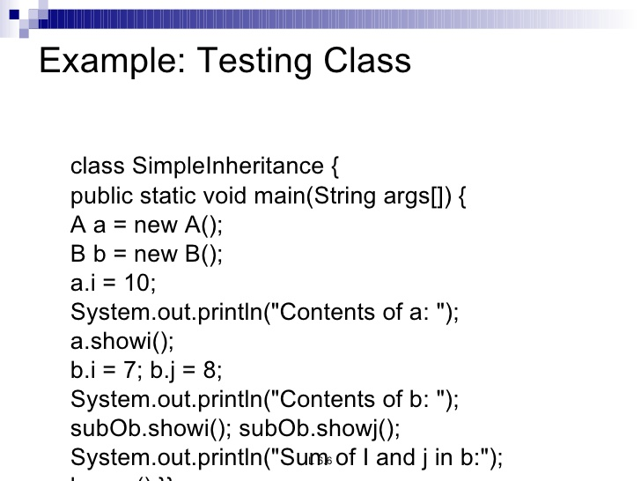
inheritance

Slide 23
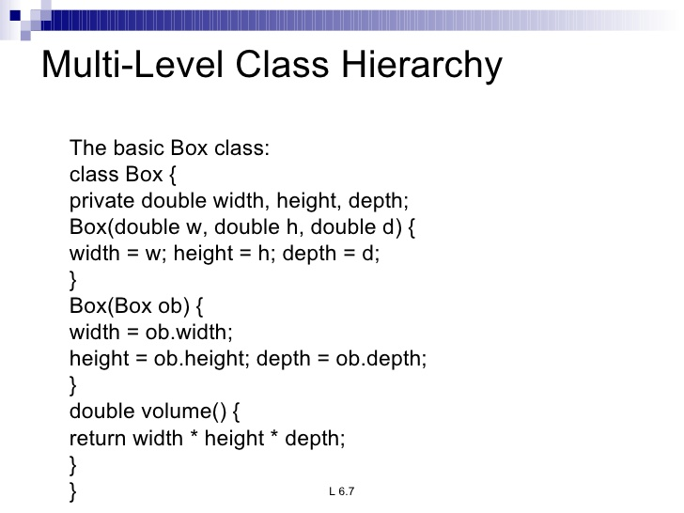
inheritance

Slide 24
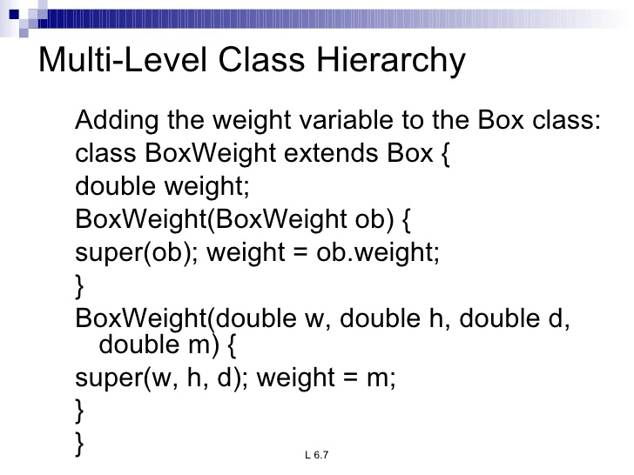
inheritance

Slide 25
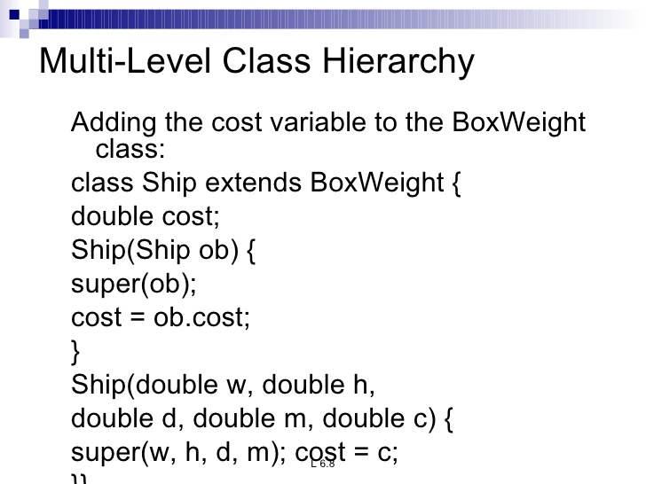
inheritance

Slide 26
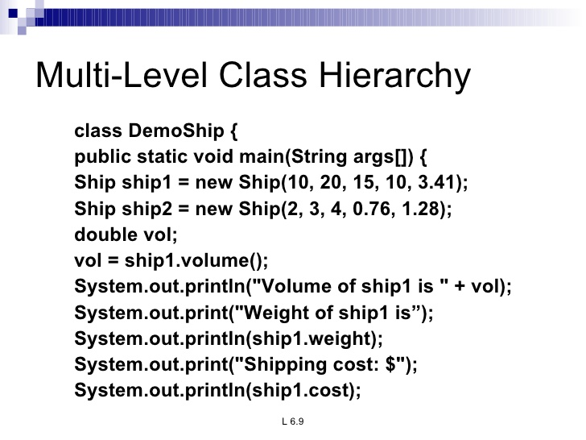
inheritance

Slide 27
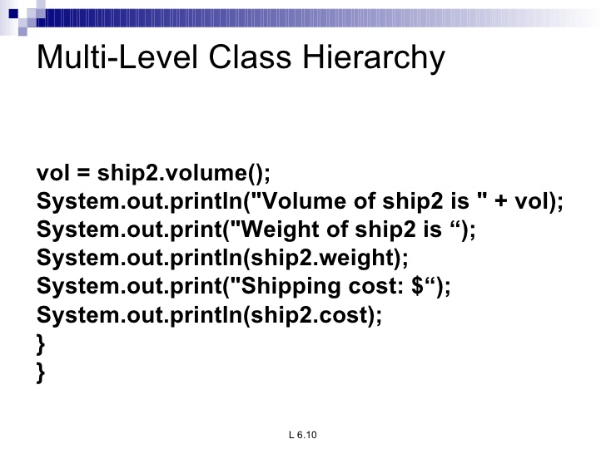
inheritance

Slide 28
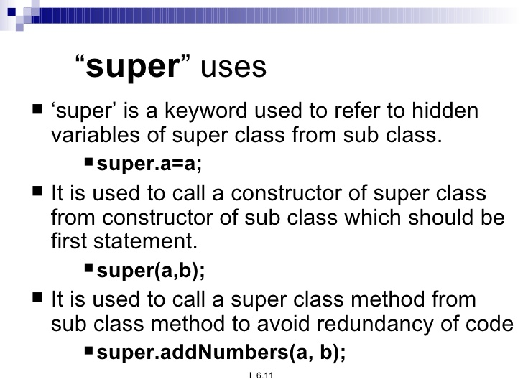
inheritance
Lab13.4: Demonstration of using super in sub classes:

Slide 29
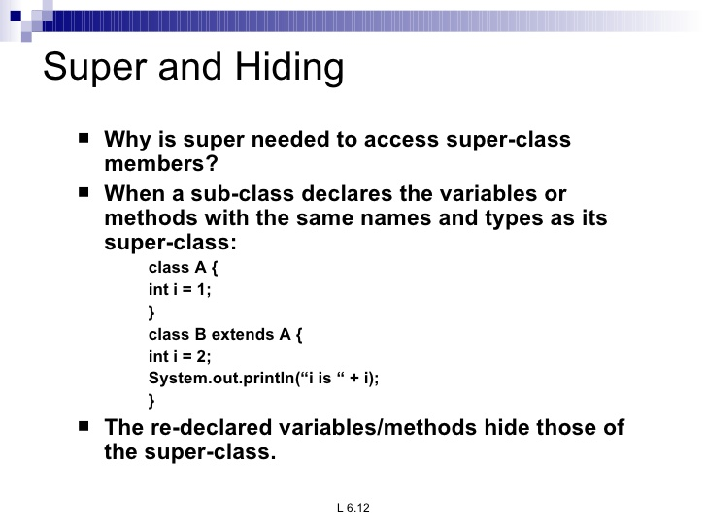
inheritance

Slide 30
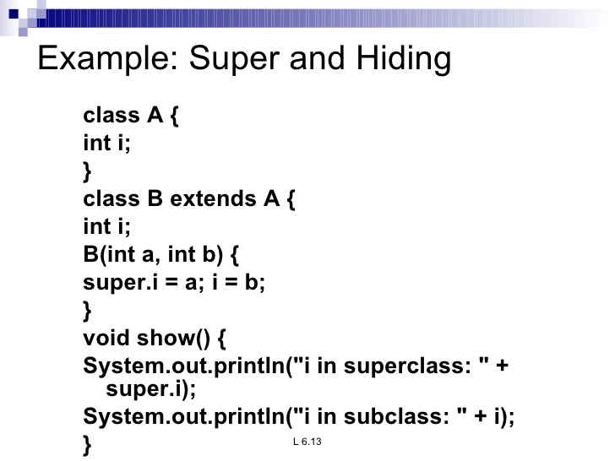
inheritance

Slide 31
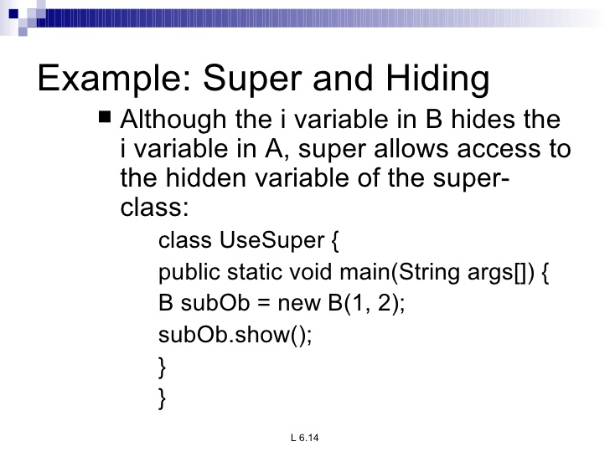
inheritance

Slide 32
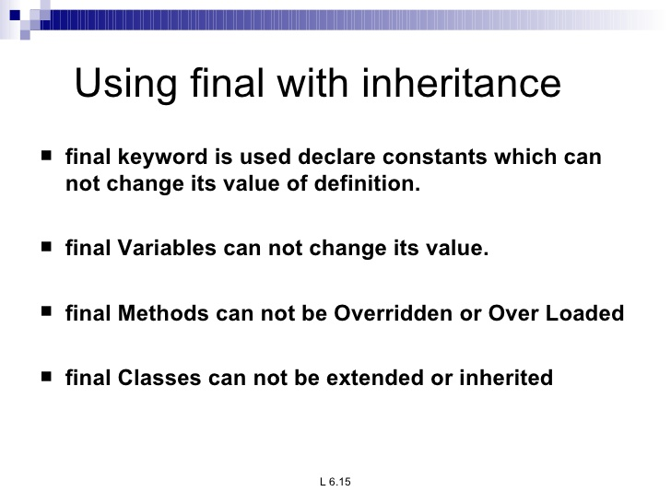
inheritance

Slide 33
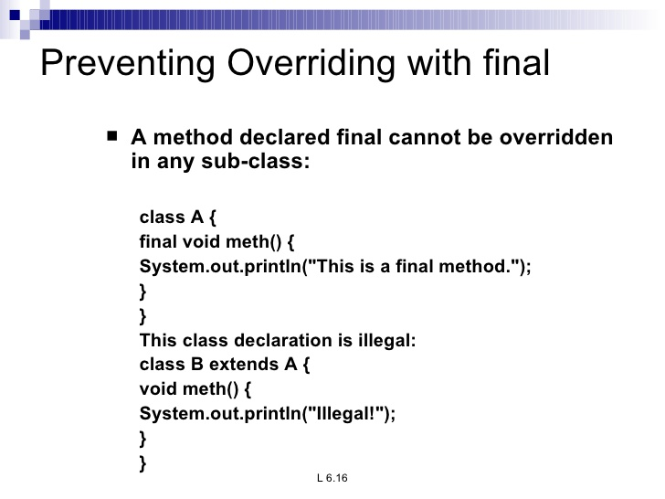
inheritance

Slide 34
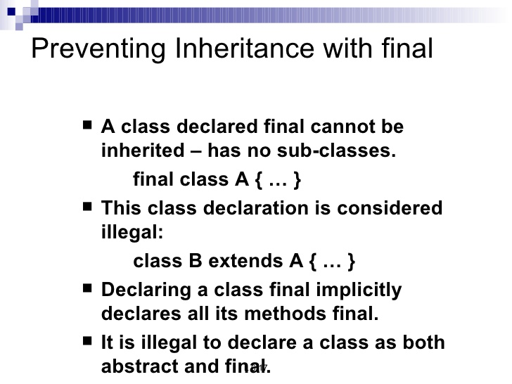
inheritance

Slide 35
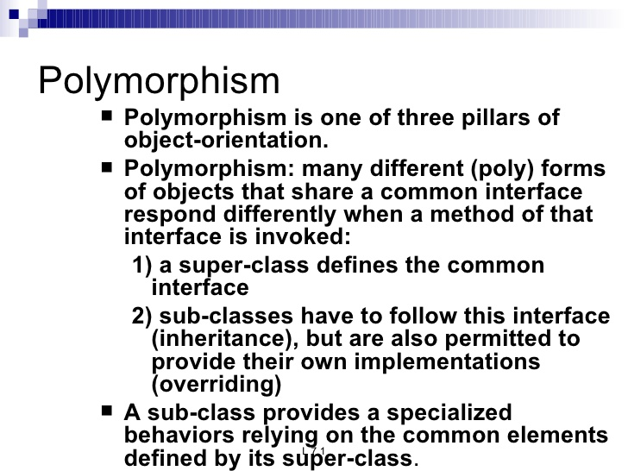
inheritance

Slide 36
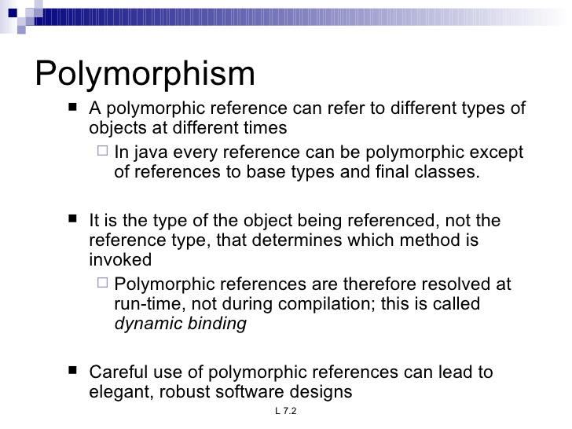
inheritance

Slide 37
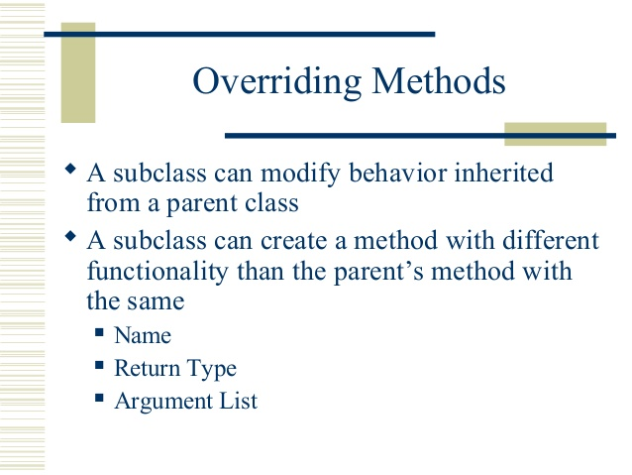
inheritance

Slide 38
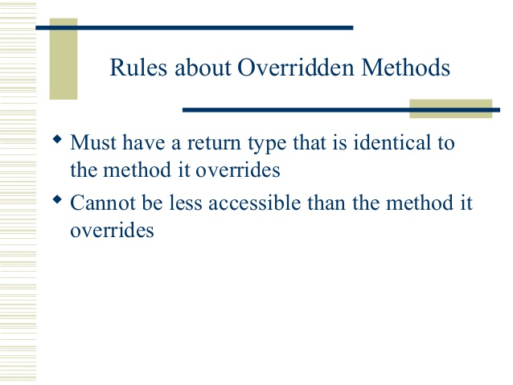
inheritance

Slide 39
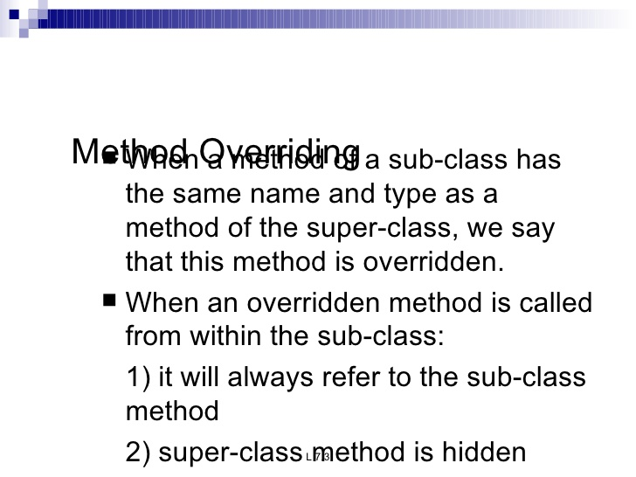
inheritance
Lab13.3: Demonstration of interface method overriding:
Lab13.2: Demonstration of static method overriding
Lab13.3: Demonstration of interface method overriding:

Slide 40
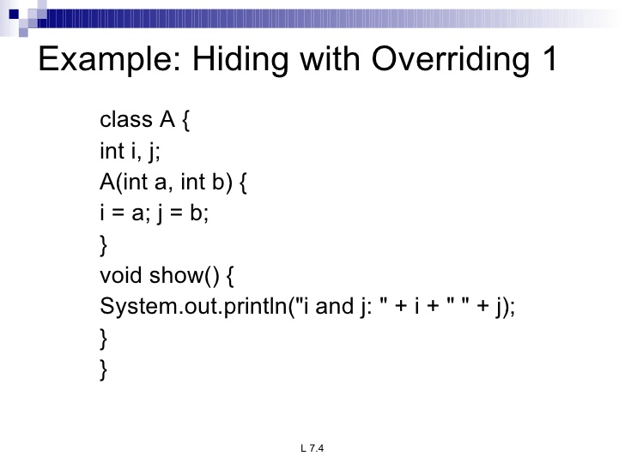
inheritance

Slide 41
inheritance

Slide 42
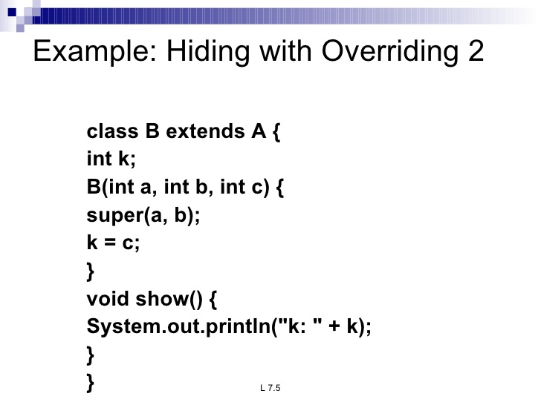
inheritance

Slide 43
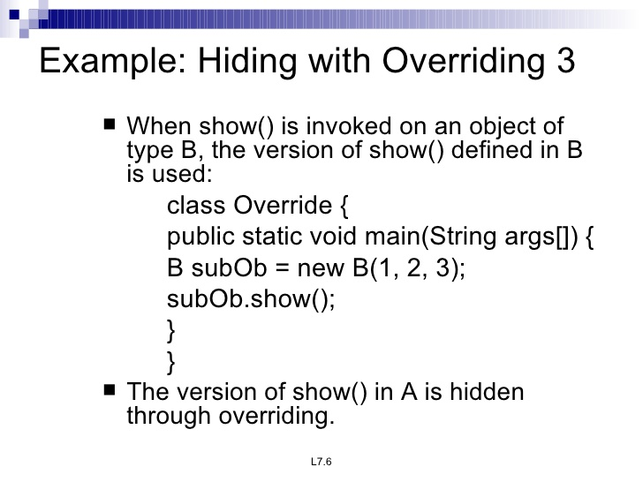
inheritance

Slide 44
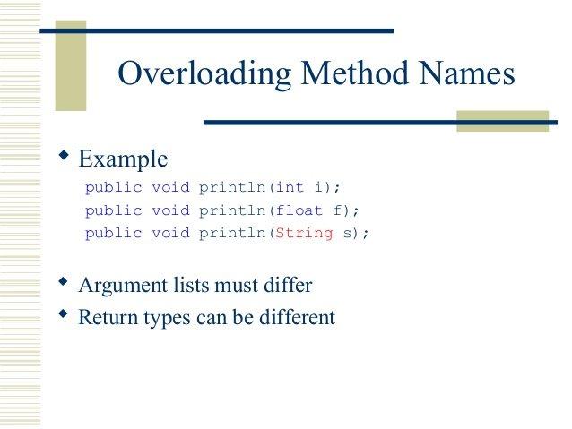
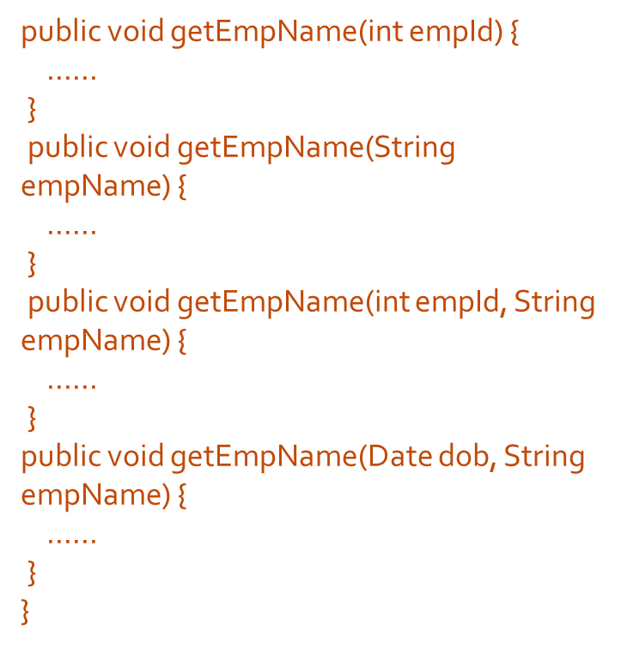
inheritance

Slide 45
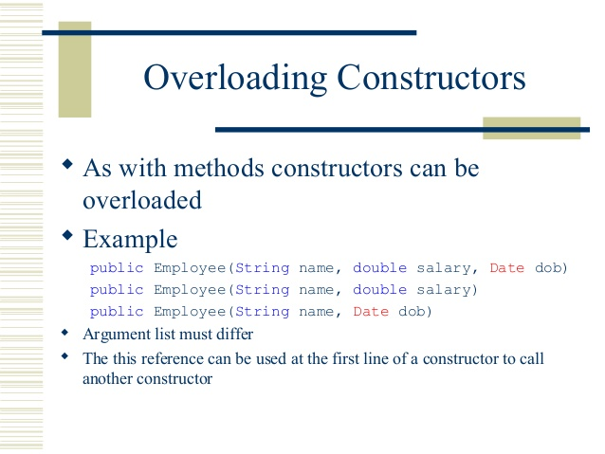
inheritance
Ex:
Java.io.PrintStream
PrintStream format(Locale l, String format, Object... args)
PrintStream format(String format, Object... args)

Slide 46
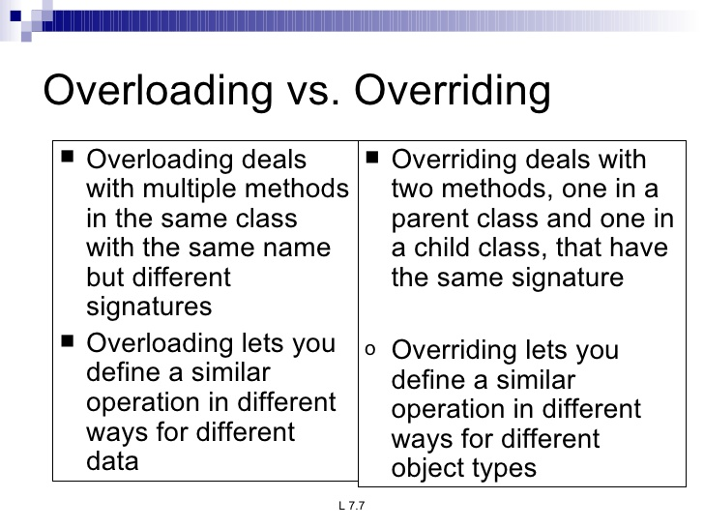
inheritance

Slide 47
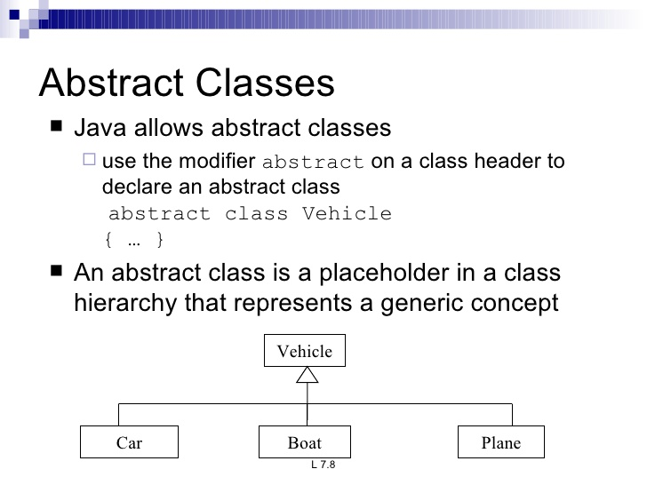
inheritance

Slide 48
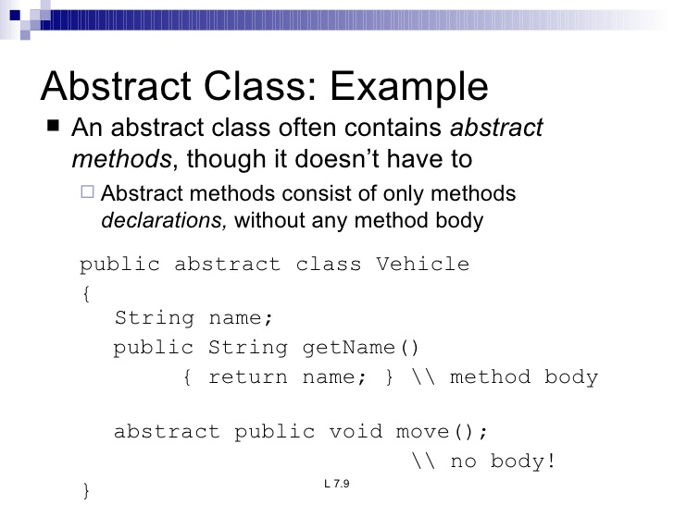
inheritance

Slide 49
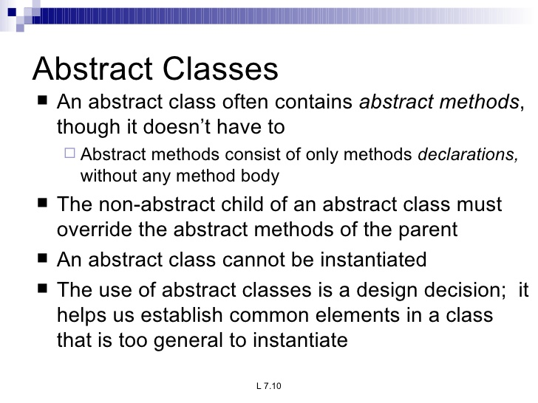
inheritance

Slide 50
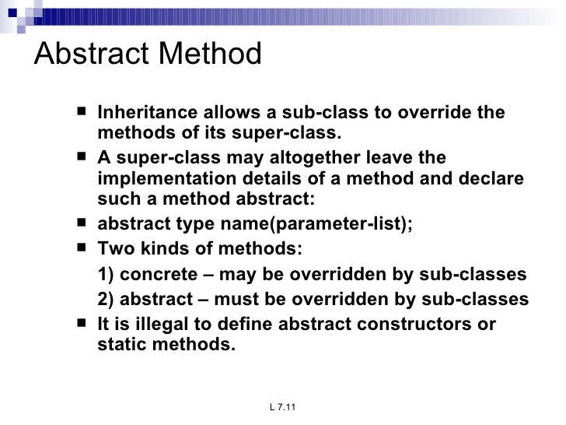
inheritance

Slide 51
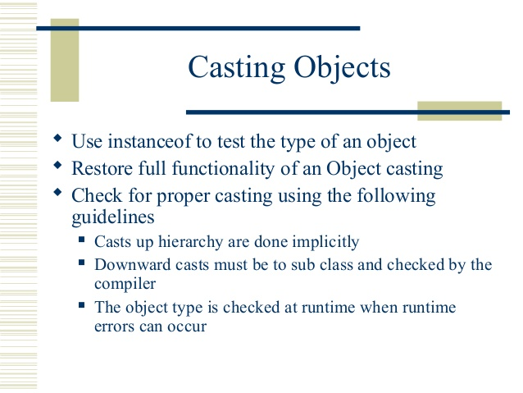
inheritance
public class Bicycle{
}
public class MountainBike extends Bicycle{
}
MountainBike myBike = new MountainBike();
Object obj = new MountainBike();
MountainBike myBike = (MountainBike)obj;
if (obj instanceof MountainBike) {
MountainBike myBike = (MountainBike)obj;
}

Slide 52
inheritance
Object class : The super class of all classes:

Slide 53
inheritance
Final classes and methods
Methods defined as ‘final’ cannot be overridden in subclass.
A class can also be defined as ‘final’. Eg: java.lang.Math
A final class cannot be sub classed

Slide 54
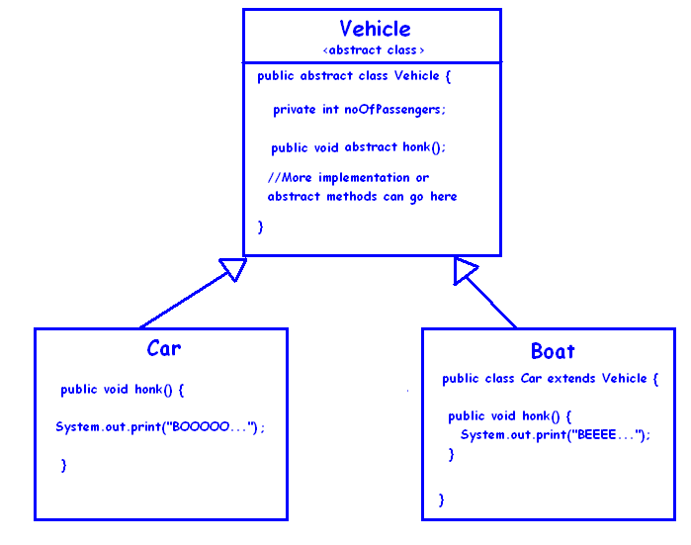
inheritance
Abstract Class:
Abstract class may or may not include abstract methods.
They are declared ‘abstract’.
They cannot be instantiated but they can be sub classed.
If a class has atleast one abstract method the class itself needs to be declared abstract.
If an abstract class implements interface, it is not necessary to implement all methods of interface.
An abstract class can have static members.
Ex:public abstract class GraphicObject {
// declare fields
// declare nonabstract methods
abstract void draw();
}

Slide 55
inheritance
When to use Abstract class / Interface ?

